Slide 1
ANALYSIS OF FACTORS INFLUENCING CAMPUS PLACEMENTS
Team Members:
Shreya Rastogi 19BCE0756
Rahul Gudivada- 19BCE2469
Glenn Varghese George- 19BCE2495
Advika Srivastava -19BCE2217
Shruti Garg- 19BCE0994

Slide 2
INTRODUCTION
When a student joins a college or any institute the first thing that they have in mind is that they will get a good placement from this college after graduation. Campus placements help the students to get a platform for themselves and they don’t have to struggle themselves in the search for a job. Hence it is important to properly analyze the whole process of placements.
In order to perform thorough data analysis, we chose a data set that consists of Placement data of students on the campus. It includes secondary and higher secondary school percentages and specialization. It also includes degree specialization, type and Work experience and salary offers to the placed students. This analysis will help students understand the process and will help them in getting better results in the future.

Slide 3
ALGORITHM DESIGN
1)Reviewing Existing Work and Identifying the gaps: We conduct a literature survey and identify the solution addresses as well as the gaps in their results.
2)Dataset Collection: We use a dataset from kaggle – “Factors affecting campus placements” for our data.
3)Visualizing data: Here we find the best graphical representation of our data. i.e. bar charts, pie charts, box plot etc.
4)Recording Observations: We record the observations from the data.
5)Encoding Data: Here we translate the data into a visual element on the plots we are making.

Slide 4
ALGORITHM DESIGN
6)Train and split: We divide the training sessions by body regions into two: one for training and one for testing.
7)Prediction: Here we Predict whether the candidate will be placed or not based on some predictors.
8)Results and Observations: From the plots and charts, we get the information we need and make observations for patterns, averages etc.
9)Conclusion: From our observations we conclude how each student gets placement and their salary package based on gender, their marks, the courses they chose etc.

Slide 5
MODEL USED FOR PREDICTION
We have first checked using
LOGISTIC REGRESSION:
Logistic regression uses a logistic function to model a binary dependent variable. From the confusion matrix, we have correctly predicted 42 (placed) + 14 (not-placed) correct predictions and 7 (not placed as placed) + 2(placed as not-placed) incorrect predictions.
After calculating the accuracy score, we found it as 86.15%
DECISION TREE:
Decision tree uses multiple algorithms to decide to split a node into two or more sub-nodes.The decision tree splits the nodes on all available variables and then selects the split which results in most homogeneous sub- nodes. We found that at depth 8 the accuracy score of the tree was highest. After calculating the accuracy score, we found it as 86.154%
This was similar to what we achieved using logistic regression so they worked equally well.
ENSEMBLE MODEL:
We will train a voting classifier using our previously trained logistic regression and decision tree model. After training and testing the cases, we found the accuracy have increased to 92.3%.

Slide 6
TASK ABSTRACTION- ACTION
ANALYZE -
Consume:
We have chosen a dataset which provides us with a table containing factors which influence the campus placements. These factors can be analyzed and compared to find out some trends and important factors.
Produce:
Our production goal is to “derive”. From the present dataset we can produce a prediction model which will help students understand their chances of getting placed or not. The applicability of this feature will help students to understand what are the factors they need to improve in order to get a good placement package.

Slide 7
TASK ABSTRACTION- ACTION
SEARCH -
We are doing an analysis of all the factors to find out their role in placements and thus don’t have any fix target. Also the location is not known as any of the factor might play a prime role. So as both target and location are unknown, our search method is “explore”.
QUERY-
After the searching mechanism we have provided a comparison of all the factors as well as a provide a comprehensive view i.e. “summary” of these factors through histogram.

Slide 8
TASK ABSTRACTION- TARGETS
Using one or two variables:
● Does the candidate's gender ( male or female ) have any role in placement?
● Does 10th and 12th percentage matter for one to get placed?
● Which degree specialization is much demanded by corporate?
● Determine the average salary offered during placements and its factors.
Using all the attributes:
● Which factors influenced a candidate in getting placed?
● Play with the data conducting all statistical tests.
● To provide a summary of all the factors and show correlation between them.

Slide 9
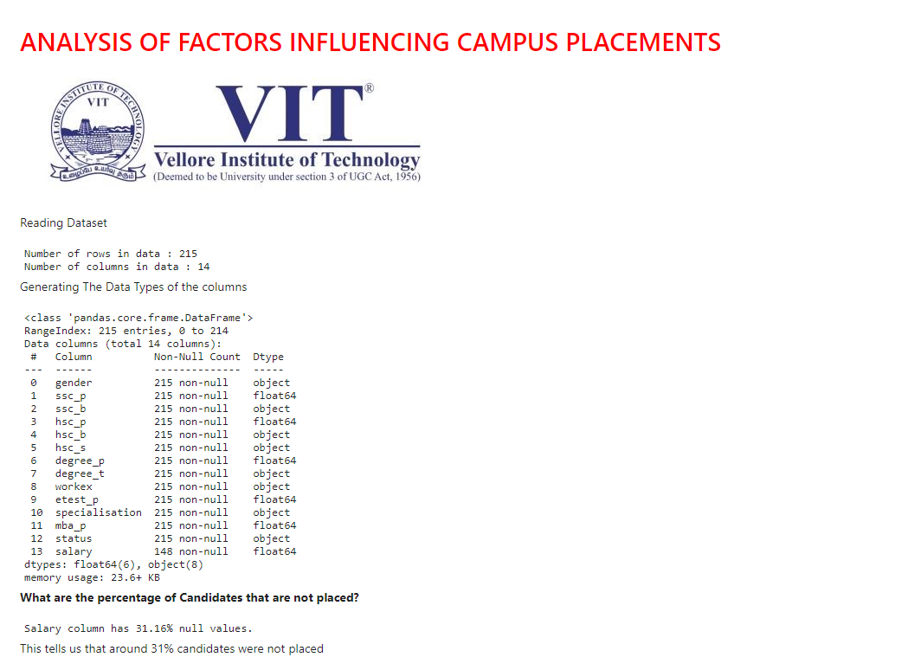
DASHBOARD IMPLEMENTATION(Voila)

Slide 10
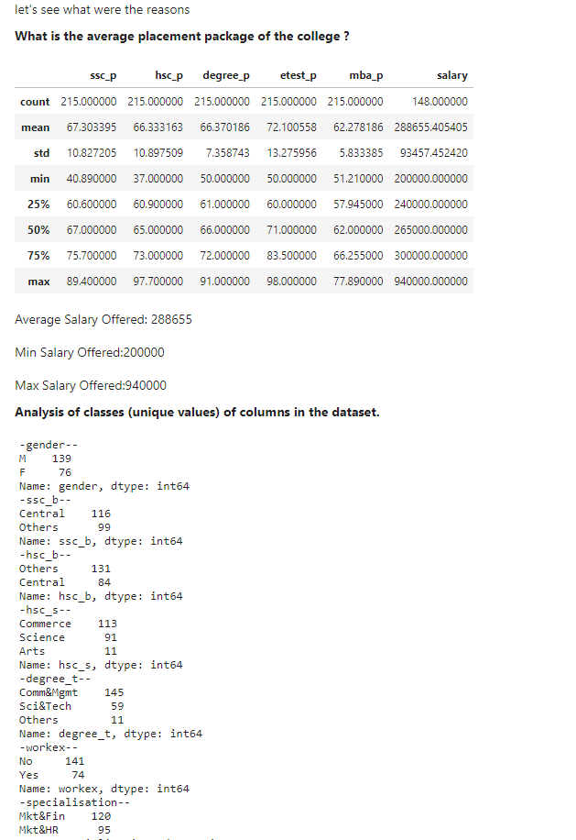

Slide 11
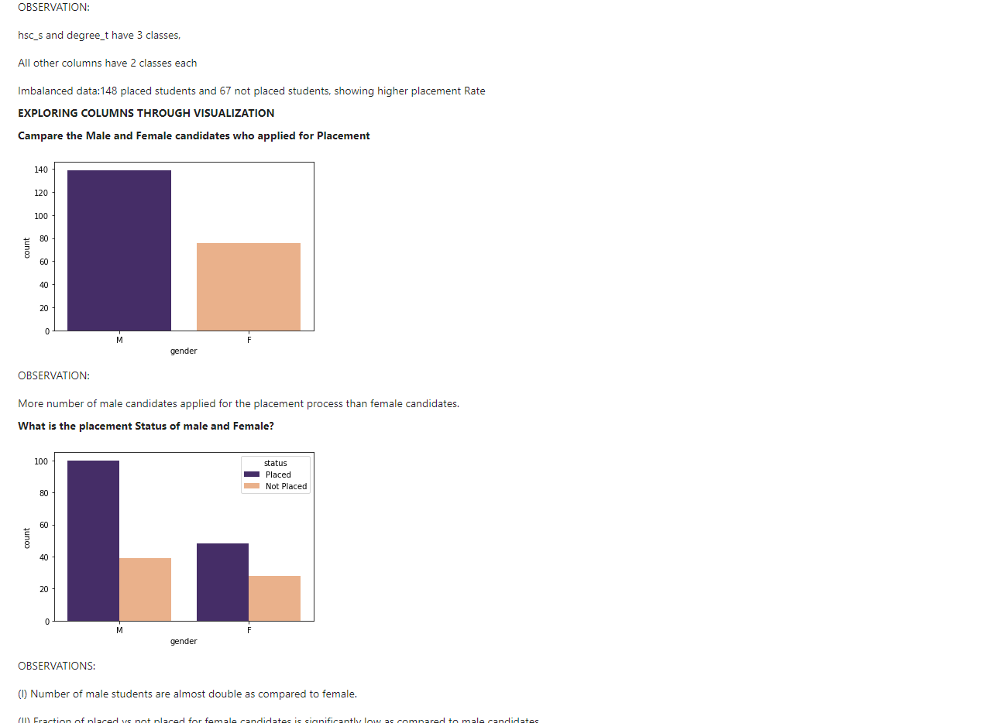

Slide 12
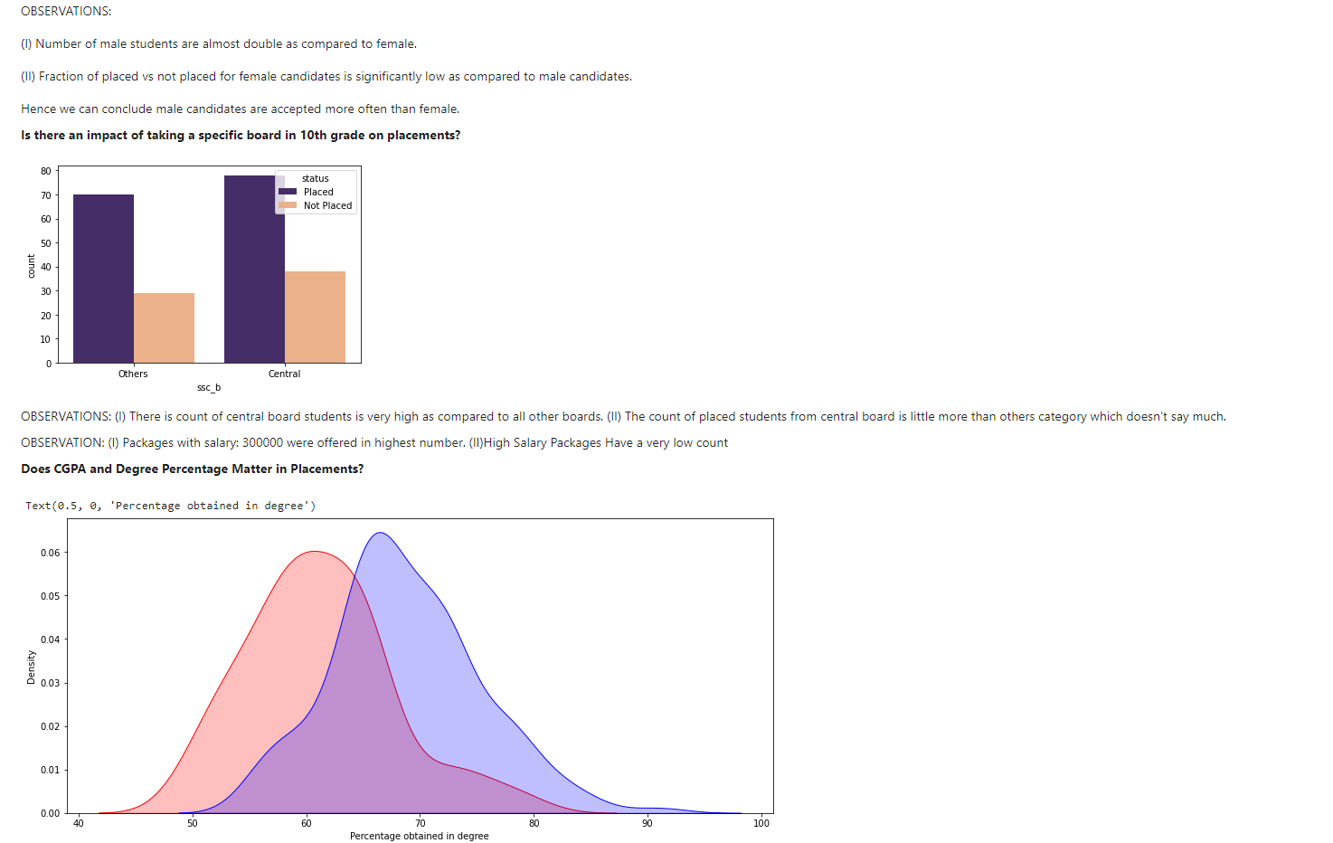

Slide 13
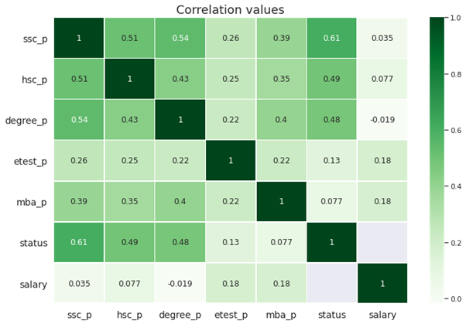
RESULT ANALYSIS
The ssc_p,hsc_p,degree_p have higher correlation with status, hence affect the placement procedure more.

Slide 14
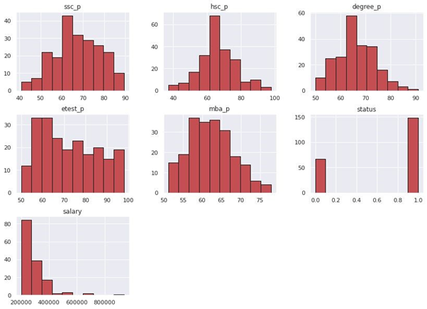
RESULT ANALYSIS
Summary(Histogram Distribution)

Slide 15
CONCLUSION
Following conclusions can be drawn with respect to the given factors from the implementation:
Gender Factor:
More male candidates got placed as compared to female candidates.
Male Candidates got higher CTCs as compared to female candidates.
Boards and Branch Factors:
Type of Board chosen does not have any effect on placements thus we can drop in preprocessing steps.
Most of the students preferred Central board in 10th grade whereas other boards in 12th grade.
Candidates with higher percentages have better chance of placements.
Choosing Science and Commerce as Specialisation seems to have perk when it comes to placements.
Commerce is the most popular branch among candidates.

Slide 16
CONCLUSION
Salary Analysis:
Maximum package was bagged by male candidate from Mkt&Fin branch which is around 940k.
Mean CTC is around 220k for male and female candidates individually.
Choosing Sci & Tech and Comm&Mngmt as degree will fetch you higher CTCs.
Mkt&Fin major have higher salaries and more placement chance as compared to Mkt&HR.
Employability test percentage and MBA percentage does not affect the placements.

